Slide 1


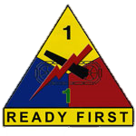





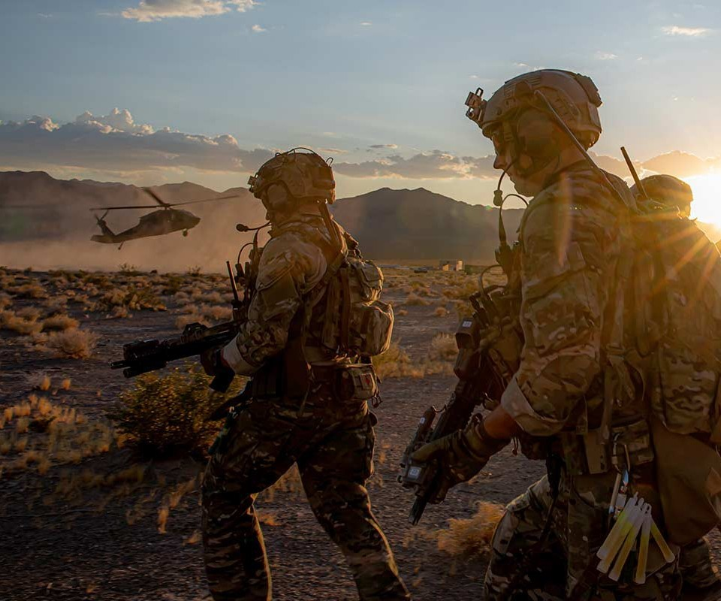



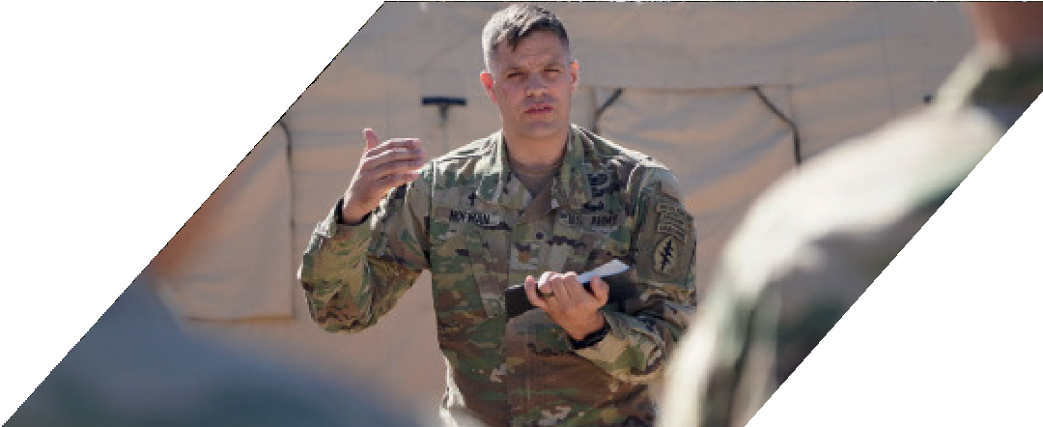
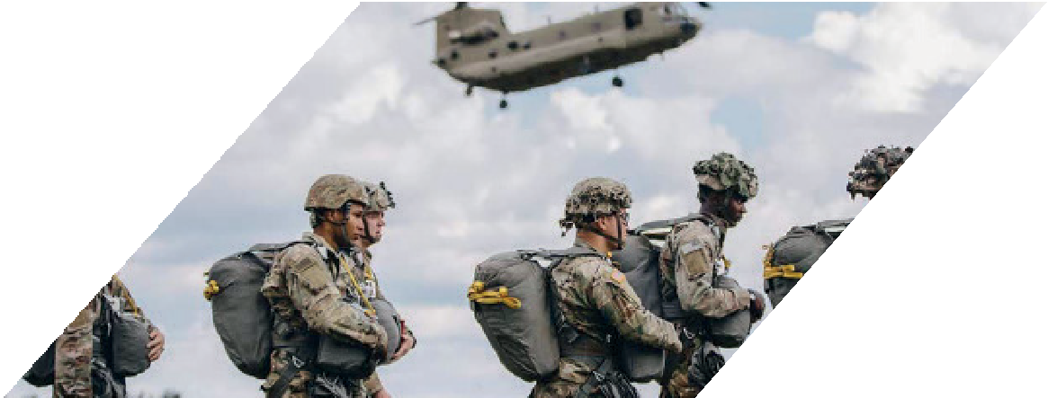












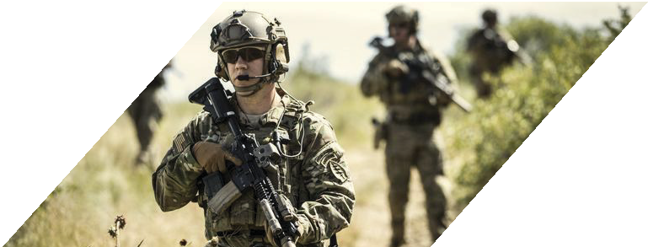






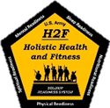

SPIRITUAL PERFORMANCE GUIDE

Slide 2

















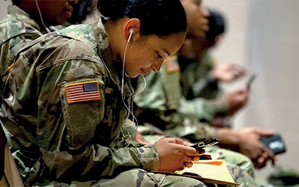
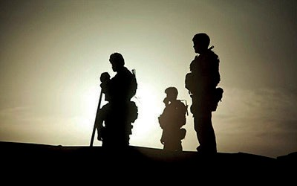



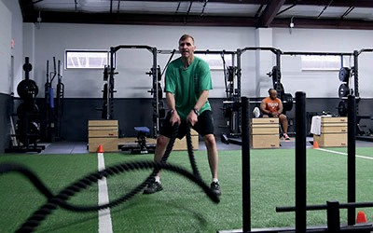












What matters most?
"The SOLDIER’s heart, the SOLDIER’s spirit, the SOLDIER’s soul, are everything. Unless the SOLDIER’s soul sustains him he cannot be relied on and will fail himself and his commander and his country in the end…"
Gen George Marshall
Nobel Peace Prize Award speech 1953
MIND
SPIRIT
BODY
FAMILY

Slide 3














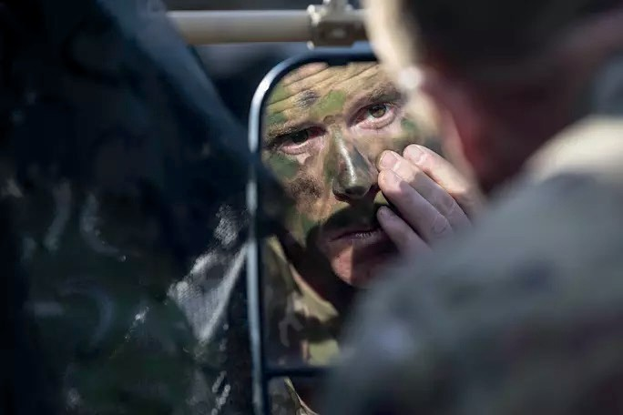
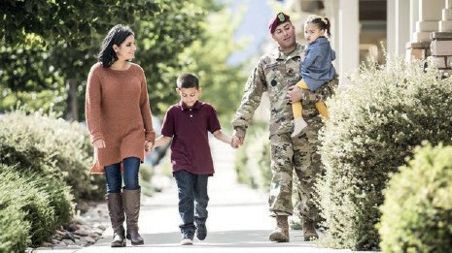
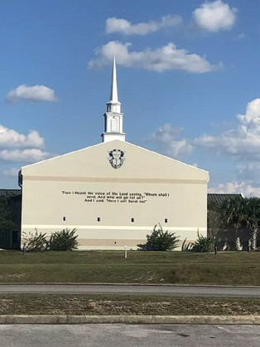





THE MISSION
H2F is the holistic integration of the Physical, Mental, Nutritional, Injury Control, and Spiritual Performance domains specifically designed to improve operational performance, ensure RFCT readiness, and build resilience of our Soldiers.
OUR VISION
A Ready First Combat Team that is at the peak of performance prepared to engage all missions while maintaining resiliency, Family, and holistic wellness throughout their service and beyond.
We accomplish this by:
Optimizing human performance through integrated evaluations, coaching, education, training, and services for our RFCT personnel.
Sustaining the holistic health of our current personnel and their families with appropriate resources and integrated approaches to mitigate the effects of acute and chronic stress during their time in RFCT.

Slide 4














SPIIRIITUAL DOMAIN
SPIRITUAL PERFORMANCE MISSION
The Spiritual Domain is designed to provide, connect, strengthen, and assess the spiritual fitness of the individual and collective battalions across the Ready First Combat Team.
Spirituality supports human performance by fostering spiritual practices, spiritual resilience, character ethics, values and beliefs, meaning and purpose, and belonging. Spirituality is incredibly individualized and the Spiritual Domain provides support to all, regardless of belief. This domain focuses on both beliefs (core beliefs, values, and sense of meaning and purpose between an individual and a higher power) and behaviors (healthy relationships, ethical decision-making, connection, and positive living between an individual and world around them).
SPIRITUAL PERFORMANCE VISION:
RFCT Soldiers and Civilians perform spiritually at optimal levels and peak performance in diverse, unique environments; Families and individuals are nurtured and thriving amidst challenging demands in order to effectively, efficiently, and safely accomplish the ready First mission.
SPIRITUAL PERFORMANCE
LINES OF EFFORT:
Deepen the Spiritual Core of RFCT Warriors and Families
Develop Trained, Equipped and Ready UMTs
Design Religious Support Capabilities for Emerging Requirements

Slide 5

























SPIRITUAL
HEALTH
Spirituality is a sense of connection that gives meaning and purpose to our lives and develops within us the qualities we need to persevere through times of adversity, hardship, and stress in ways that help us grow from our experiences. As we think about spiritual wellness, we want to think about life purpose and the path, practices, and people that will help us live in ways that will enable us to live that purpose.
ANSWER YES (Y) OR NO (N)
I believe that my life has a purpose and meaning
I regularly engage in practices that connect me to something bigger than myself
I have a set of core values that guide the choices and decisions I make
I want to discover ways to connect deeper with my God, higher power, and life purpose
I know the steps to take that will lead me to fulfill my purpose in life.
I am connected to a community of people in which I feel valued, heard, and understood
There is at least one thing in my life that I am passionate about and driven to do
I am connected to a group of people that share my life purpose that help me become more connected to it and grow in my progress to living it.
I am religious
I am aware of resources and services available to me to strengthen, sustain, and grow in my spiritual wellness.
TOTAL ANSWERS OF “YES”

Slide 6



















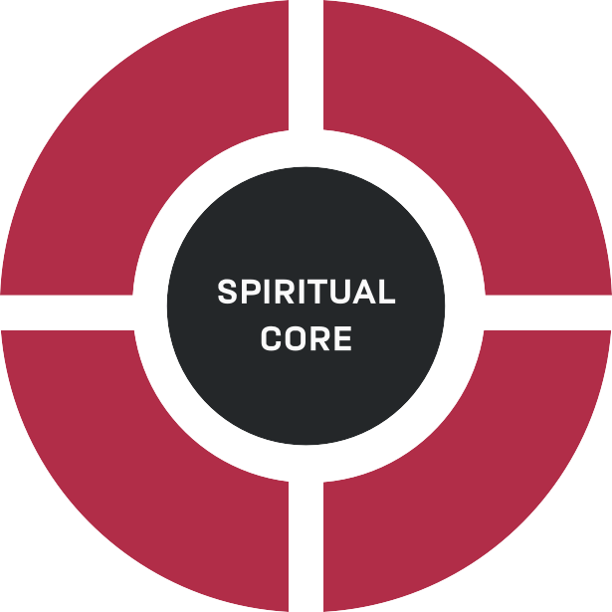


THE WAY TO
SPIRITUAL WELLNESS
Spiritual wellness is essential to our overall health and fitness because from our spiritual core we gain a sense of purpose and meaning in our lives. Having a sense of purpose and meaning in life allows us to make sense of the world around us and our place within it. A strong spiritual core also helps us respond more calmly to stress and stressful situations by allowing us a grid through which we can make sense of the things happening around us. Finally, spiritual wellness reduces anxiety, depression, and other emotional struggles we may face by allowing us to see how our struggles mold and shape us to become who we need to be to live with and fulfill our purpose.
Spiritual wellness is not specifically tied to religion. For many people, their spiritual core is directly tied to
their religious beliefs and values. The guidelines of religion drives the direction and purpose of this person’s life. For many people, spirituality is directly tied those things that connect them to something that is bigger than themselves. Whatever way we define spirituality, our spiritual wellness matters as it is the foundation upon which the rest of our lives are built.
E
S
P
O
A
P
T
R
H
U
P
P
E
R
L
A
P
C
O
T
E
I
P
C
E
S
THE 5 SPIRITUAL STEPS
STEP 1
STEP 2
STEP 3
STEP 4
STEP 5
Identify the overarching purpose of your life?
Establish the path you need to follow
Practice the disciplines that will
Connect with a community and
to fulfill your purpose?
strengthen your ability to fulfill your purpose in life
resources that will
Help others live with purpose
help your live and fulfill your purpose in life

Slide 7

Develop the
Spiritual Core
A SPIRITUAL CORE SHAPES DEVELOPMENT
MEANING, PURPOSE, CALLING AND CONNECTION
DEVELOPMENTAL TASK
WITH SPIRITUAL CORE
WITHOUT SPIRITUAL CORE
Self
Inherent Worth
Abilities Based
Identity
Meaning & Purpose
Aquiring Success
Work
Calling & Contribution
Talents & Gains
Relationships
Sacred, Share Love & Grow
Pleasing, Meet Needs
Path
Always Connected
Ultimately Alone
Place in the World
Purposeful World
Random World
Existential Reality
Love, Life-giving
Unknown
Good Events
Blessings
Deserved, Luck
Bad Events
Opportunities, Learning
Random, Failure
Dr. Lisa Miller discusses the importance of the Spiritual Core.
https://vimeo.com/567031417
Password: SpiritualReadiness
Dr. Lisa Miller
Spirituality Mind Body Institute | Teachers College, Columbia University

Slide 8

















SPIIRIITTUAL REFLECTION
PURPOSE
What gives my life meaning and purpose?
Do I believe that my life has purpose?
If not, why not? If so, what is the purpose?
What is my vision of the future?
What is my hope for the future?
What perceptions do I have about myself that give me inherent value?
How do I answer the question, “Who am I?”
PATH
What is my spiritual path (faith-belief-worldview)?
What does my worldview and associated beliefs say about who I am in relation to others?
What mindset do I use to progress through life?
On what do I base this mindset?
In what do I engage that shapes this mindset?
What am I reading to reinforce this mindset?
PRACTICES
What are my most effective spiritual practices?
What, if anything, has worked well? What has not worked?
How do I typically respond when experiencing adversity?
How can I improve my ability to cope with adversity?
Over what do I have ability to exercise control?
What can I do about adverse situations in my life I cannot control?
How do I handle guilt and shame?
PEOPLE
To Whom do I feel most spiritually connected?
How am I reinforcing those connections?
What connections cause significant distress?
How can I healthfully disconnect from those?
How can I re-establish damaged connections?
Who, if anyone, do I need to forgive to include myself?
What do I consider my spiritual community?

Slide 9















SPIRITUAL REFLECTION
SPIRITUAL FACTORS | REFLECTIVE QUESTIONS
PERSONHOOD | What perceptions do I have about myself that give me inherent value? What gives my life meaning if anything? Do I believe that my life has purpose? If not why not? If so, what purpose?
IDENTITY | What do my worldviews and associated beliefs say about who I am in relation to others? How would I answer the question "Who am I?"
GROWTH ORIENTATION | What mindset do I use to progress through life? On what do I base this mindset? In what do I engage that shapes this mindset? What am I reading to reinforce this mindset?
PERSONAL AGENCY | Over what do I have the ability to exercise control? What aspects of my life arecompletely out of my control? What can I do about adverse situations in my life over which I have no control? How do I handle guilt and shame?
COPING STRATEGIES | How do I typically respond when experiencing adversity? What, if anything, has worked well? What has not worked? How can I improve my ability to cope with adversity?
CONNECTION | To what or whom do I feel most connected? How am I reinforcing those connections? How can I healthfully disconnect from those? What connections cause significant distress? If disconnection is impossible, how can I manage the connection to minimize the distress? How can I re-establish damaged connections? Who, if anyone, do I need to Forgive, to include myself?

Slide 10















IDENTIFY
YOUR PURPOSE
ESTABLISH A LIFE WORTH LIVING
The following exercise will help you to identify purpose and meaning in your life. It is meant to provide a way to define the overarching purpose of your life, or what you are living for. This overarching purpose provides the means to develop a path, practice specific disciplines, and connect with specific communities to help you successfully live with purpose.
5 DEEP QUESTIONS
Take time to reflect on these questions and write your answers in the spaces below.
1.
At the end of your life, what do you want people to say about you (who you were, what you did, and the impact you made on others and the world)?
2. What makes these things important to you?
3.
If you could do one thing with your life that would change the world, what would it be and why?
4.
What does it mean to you for life to feel right?
5. What is the most important thing/person in your life and why?
As you worked through these questions , are you beginning to get an idea of what the overarching purpose may be for your life? If so, write it down here…
My Purpose in Life is...

Slide 11



























PLOT YOUR PATH
It has been said that the journey of a million miles begins with one step. Taking the first step of committing to live life with purpose may be the most difficult to take but when we take that first step, we find that our lives have greater meaning than just getting up and going to work or school. When we commit to living with purpose we realize that we are living for something bigger than ourselves and we begin to add and remove things in our lives so that we can live more intentionally for our overarching purpose in life.
Sometimes we don’t live our lives with purpose because we simply don’t know how. The exercise below will help design your path to living with purpose by helping you set the core values, beliefs, guiding principles, commandments, etc. that provide directions to your destination. It will also help you identify obstacles that are in your path blocking you from moving towards your destination so that you can work to remove them.
STEP 1
STEP 2
STEP 3
STEP 4
Identify what you currently have for the journey, what you need to complete the journey, and who
is with you on the journey
(What are you currently doing to live for your purpose? What else do you need to fully live your purpose? Who can best help you live your purpose?)
Determine the destination
Set the course
Identify the obstacles blocking your path
(What is your overarching purpose for your life?)
(What core values, beliefs, principles and/or commandments lead you to live for your purpose?)
(What is currently keeping you from fully living for your purpose?)
My Destination (Purpose I’m Living for)
My Core Values, Beliefs, Principles, and/or Commandments that will keep me on track:
My Obstacles that keep me from living my purpose:
My Starting Point
What am I already doing to live my purpose?
What do I need to better live my purpose?

Slide 12











SPIRITUAL PERFORMANCE
FOCUS AREAS:
Not sure where to begin increasing your spiritual performance? These focus areas may guide your journey!
BELIEF:
This area focuses on resources to increase one’s fundamental knowledge related to their core beliefs, values, self-awareness, and experiences that inform an individual’s behaviors and actions. The focus is inward, developing your spiritual core which provides stability and resilience in times of difficulty.
Core Values/Beliefs (Spiritual and Religious): This area includes resources on deepening one’s individual spiritual/core beliefs through general and faith specific resources (i.e. Bible Studies, devotionals, sacred text readings/commentaries, basic “doctrine cheat sheets”, etc.)
Moral Leadership: This area focuses on resources critical to the foundation of moral leadership and development from both a spiritual as well as 165-1, ADRP 6-22, DA PAM 165-18 perspective.
Character Building/Army Values: This area focuses on our common values as an Army and how to cultivate these values into our daily lives IAW ADP 6-22 and their intersect with a spiritual/faith perspective.
Mindfulness/self-awareness: This area focuses on resources related to being present in the moment, mindful of one’s self and others, and the ability to slow down and reflect.
Meaning and Purpose: This area is centered on helping individuals answer the question of “why” from various perspectives (i.e. existential meaning, professional meaning, purpose of individual within a family or community, etc.)

Slide 13








BEHAVIOR:
This focus area provides resources that promotes positive behaviors that impact decision-making, healthy relationships, and living with purpose and meaning. The focus of this category is outward, providing “muscle-memory” in times of difficulty, increasing personal gratitude and sense of connectedness with others.
Service to others: This area is focused on ways to serve others, the positive impacts of service, and links/resources to various service opportunities.
Forgiveness: This area provides resources on the “what” and “how” of forgiveness, both in order to forgive others as well as one’s self.
Spiritual Disciplines: This area will provide tangible “how to” on various spiritual disciplines both in general (i.e. meditation or journaling) as well as faith specific (i.e. Prayer from a Christian, Jewish, Muslim, etc. perspective).
Healthy Relationships: This area provides helpful relationship techniques (communication, conflict management, active listening, team building, etc.) in order to improve one’s both personal and professional relationships.
Ethical Decision-Making: This area provides material to assist developing ethical
decision-making from a variety of methods, to include vignettes, decision-making models, articles, and training plans.
Faith Community Engagement: This area provides connection to faith communities and demonstrates the value of being connected to a like-minded group in order to promote healthy accountability, spiritual growth, and development utilizing various resources (links to online religious services, groups, communities, articles on the benefits, etc.)
MORAL INJURY:
The spirit or moral self can be injured just as much as the body or mind. This focus area examines the impact of warfare and life on the soul and provides resources to heal when injury occurs.
Understanding Moral Injury: This area provides scholarly resources on what Moral Injury is, its impact, and its correlation with PTSD and other issues.
Dealing with Moral Injury: This area provides tangible helps to both confront and overcome moral injury, links to resources, and exercises to work through.
Post Traumatic Growth after Moral Injury: This area is designed to provide resources and connections to individuals on how to thrive after working through moral injury or other traumatic experiences.

Slide 14



















PRACTICES FOR THE PATH
As we walk the path of purpose in our lives, it is vital that we always keep our purpose in view so that we stay on track and live for that purpose. This means that our purpose must always be in the forefront of our minds. The more we think about our purpose, the more we align our lives to live for it. The best way to focus our minds on our purpose is to discipline ourselves to do specific practices each day that will renew our sense of purpose, align our lives to that purpose, and grow stronger in our ability to live that purpose.
Reading: The practice of reading focuses our minds on our purpose. Reading fills our minds with information about our purpose, skills to better live our purpose, stories of others that have shared our purpose and how they lived for it. Reading disciplines us to set aside time daily to focus on learning about our purpose, how to change for it, and how to live it better in our lives.
Journaling: The practice of journaling allows us to keep track of our progress on our path of purpose. As we journal we are able to write freely about our successes, struggles, and questions about living our purpose.
Meditation: The practice of meditation allows us to focus on specific aspects of living with purpose on a deeper level. As we meditate we dedicate mental energy to cultivate a specific state or quality. We may focus on a principle, teaching, core value, or belief that is vital to our purpose and how that can bring peace and calm to our life situations.
Mindfulness: The practice of mindfulness enables us to focus on where we currently are on our path to living our purpose. Mindfulness is the practice of being fully mentally and emotionally present in the moment and helps us to train our minds to focus on what is happening now without being distracted by the past or the future
Prayer: The practice of prayer keeps us in communication with our God. Prayer is a religious discipline in which we communicate with our God seeking guidance, provision, and favor in our lives so that we can better live out our purpose. Prayer brings peace to our lives.
Confession: The practice of confession frees us from burdens we bear that keep us from living with purpose. Confession is the practice of admitting our faults and wrongs to others. This may be to our God, a close and trusted friend, or someone we have wronged. When we practice confession, we are able to throw off emotional weights that slow us down on the path of purpose.
Gratitude: The practice of gratitude creates within us a mindset of thankfulness for what we have in our lives and trains our minds to focus on the positive in every situation. Gratitude also allows us to appreciate the impact other people have in our personal growth and progress to living with purpose.
Generosity: The practice of generosity reminds us that living our purpose is not about us. Generosity is the practice of giving our time, talents, possessions, words, and other things to people to help them progress in life and living their purpose.
Forgiveness: The practice of forgiveness frees us from things that take our focus off living our purpose or cause us to go against the core values, beliefs, and teachings that are the foundation of our purpose.
Self-Denial: The practice of self-denial teaches us that we must put aside our wants and desires at times in order to live our lives to fulfill our purpose. Self-denial teaches us to put our purpose above ourselves and that our purpose is bigger and more important than our momentary desires.

Slide 15

























PRACTICES
FOR THE PATH
Practices I am already doing…
Practices that will help me to better live with purpose…
Practices that I would like to learn more about to help me live my purpose…
I am making the commitment to daily practice the following…
PRACTICE WHEN I WILL DO IT EACH DAY

Slide 16












PEOPLE FOR
THE PURPOSE
No one can successfully live for their purpose alone. We all need other people in our lives to walk the path of purpose with us. There is power in community connection that motivates, educates, strengthens, sustains, and empowers us to more fully and effectively live our purpose. As we walk our journey of life to live with purpose we will grow tired, we will struggle, want to give up, and wander off course. When we have other trusted people in our lives that share our purpose or that can support us on our path to live our purpose, we will find that the journey, though challenging, can be completed successfully. Community is powerful to our living with purpose. In it we find that we have value, we are heard, we are understood, we are trusted, and we are family. Below is an exercise that will help you make connections that can help you live your purpose.
Who do I have in my life that I know will support me to live with purpose?
TRUSTED
PEOPLE
GROUPS, AGENCIES, etc THAT SUPPORT YOU IN LIVING YOUR PURPOSE
PEOPLE THAT SHARE YOUR PURPOSE
What helping agencies
can help me become better at living my purpose?
Who do I know that shares my purpose?
ESTABLISHED GROUPS THAT SHARE YOUR PURPOSE
(Clubs, Religious Institutions, etc)
What groups can I connect with that share my purpose and will help me live it?

Slide 17








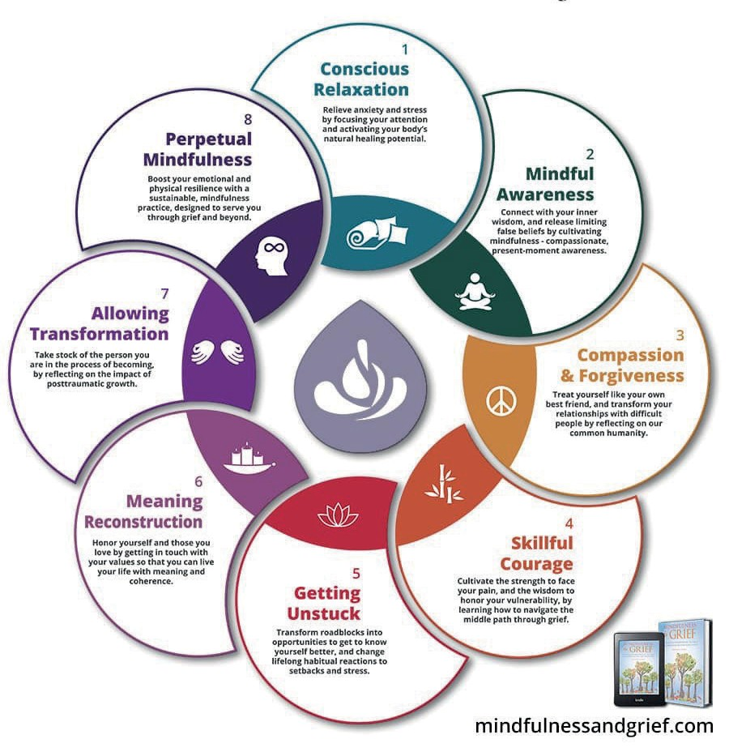


WHEN TIMES
GET TOUGH
“Regard both suffering and joy as facts of life” -Buddha (Lotus Sutra) “In this world you will face trouble…” – Jesus (John 16:33)
“Certainly We created man in travail.” -Muhammad (Quran, 90:4)
The fact is, the world is imperfect and we are going to experience times of suffering, trials, or difficulties. Each world religion acknowledges the reality that living is not always easy. Whether disappointment or unmet expectations, frustration, betrayal, or the loss of a loved one, we are going to have trials to overcome. Our Spiritual Core is what keeps us strong and stable through the storms of life, but sometimes it feels like it isn’t enough. Below are some practical ways to deal with difficulties when they arise.
MINDFULNESS & GRIEF SYSTEM
FROM

Slide 18







LIVING WITH
PURPOSE
Putting it all together to live a life of purpose...
MY GUIDING CORE VALUES, BELIEFS, AND PRINCIPLES | THE OBSTACLES IN MY WAY OF LIVING MY PURPOSE
PRACTICES I WILL DO TO HELP ME LIVE MY PURPOSE | WHAT I WILL DO TO REMOVE THOSE OBSTACLES
PEOPLE I WILL CONNECT WITH TO HELP ME LIVE WITH PURPOSE
As one that has been able to define and establish a path to purpose and meaning in your life, you know what it takes to be spiritually fit, ready, and strong. Now that you know what it takes, we want to offer three guiding principles that will help you become a source of hope, help, and strength by helping others discover the way to become spiritually strong.
Be Vigilant. People will not always tell you that they feel that their life has no meaning or purpose or that they are struggling. You must be alert.
Be Engaged. The best way to become aware of what is really going on in the hearts and minds of those around you is to be engaged with others in conversation that moves below the surface and shows that you really care about them and their life.
Be Invested. Be willing to invest your life into others to help them live for purpose. Words only go so far, but actions speak much louder. As you help others discover their path to purpose in life, be willing to walk it with them, supporting them along the way.

Slide 19







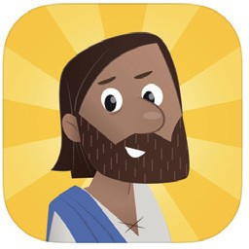
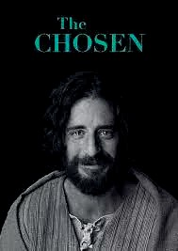

Spiritual Performance
Resources
PROTESTANT
Right Now Media
www.rightnowmediaatwork.org/Account/Invite/USARMYChaplainCorps
From Author John Eldredge “The One Minute Pause App”
www.pauseapp.com
The Bible App
The Bible App for Kids
www.bible.com/app www.bible.com/kids
The Chosen (Jesus Film series)
www.watch.angelstudios.com/thechosen/watch

Slide 20













American Bible Society:Armed Services Ministry
Resources from Armed Services Ministry
*Military Bible Challenge
*God Understands
*Hero Squad
*Journey of a Military Wife
*Never Alone
*Operation Recon
www.armedservicesministry.org
Pray as You Go
n
You Versio
www.play.google.com/store/apps/details?id=pl.foxcode.prayasyougo&gl=US
The Bible App
Our Daily Bread
The Navigators
www.odb.org
www.navigators.org/resources/
Christian Creeds & Reformed Confessions
www.apps.apple.com/us/app/christian-creeds-confessions/id359513722

Slide 21














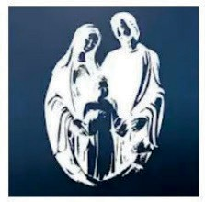



CATHOLIC
The Catholic Novena
Ave Maria Radio
https://catholicnovenaapp.com
https://avemariaradio.net/app/
Laudate
https://apps.apple.com/us/app/laudate-1-catholic-app/id499428207
https://play.google.com/store/apps/details?id=com.aycka.apps.MassReadings&gl=US
Catholic Bible
https://apps.apple.com/us/app/catholic-bible/id1516991789
https://play.google.com/store/apps/details?id=free.catholic.bible&hl=en_US&gl=US
Catholic News Agency
https://catholicapps.com/cna-catholic-news-agency-app/
Catholic Prayers: The Daily Prayer Book
https://apps.apple.com/us/app/catholic-prayers-official/id1131116859 https://play.google.com/store/apps/details?id=com.catholicprayerbook&hl=en_US&gl=US

Slide 22



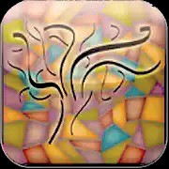
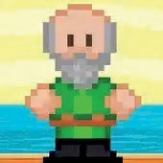





JEWISH
The Jewish Chaplain Counsel Association
Jewish resources selected and developed by Jewish Chaplains
https://jcca.org/what-we-do/jwb/jrep/
Torah TV
https://play.google.com/store/apps/details?id=io.appery.project172074&hl=en_US&gl=US https://apps.apple.com/us/app/torah-tv/id875944072
Jonah Run: An Infinite Runner Game Set in Temple Times
https://apps.apple.com/us/app/jonah-the-runaway-prophet/id1160435371 https://apkpure.com/es/jonah-run/com.gdcast.jonahRun
21

Slide 23






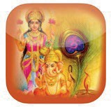


BUDDHIST
Dharma Meditation Trainer
https://apps.apple.com/us/app/dharma-seed/id507779665 https://play.google.com/store/apps/details?id=org.dharmaseed.android&gl=US
Buddha Vacana: Readings in Theravada Buddhism:
https://www.nku.edu/~kenneyr/Buddhism/index.html
HINDU
Hindu Calendar
https://apps.apple.com/us/app/hindu-calendar-panchang/id1187338109 https://play.google.com/store/apps/details?id=com.alokmandavgane.hinducalendar&gl=US
Aarti Collection
https://apps.apple.com/us/app/aarti-collection/id514300871 https://play.google.com/store/apps/details?id=com.dzo.aarti&gl=US
Vedanta eBooks
https://vedantaebooks.org
22

Slide 24

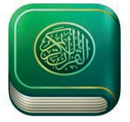












MUSLIM
iQuran
https://apps.apple.com/us/app/iquran/id285944183 https://play.google.com/store/apps/details?id=com.guidedways.iQuranPro&hl=en&gl=US
iPray
https://play.google.com/store/apps/details?id=com.guidedways.ipray&hl=en&gl=US https://apps.apple.com/us/app/ipray/id288054534
Qamar Deen
https://productivemuslim.com/qamar-deen-app-your-spiritual-development-tracker/
WORLD RELIGIONS
US. Army Chaplain Center and
School Training Portal (World Religions Resources).
https://usachcstraining.army.mil/religious-education
23

Slide 25


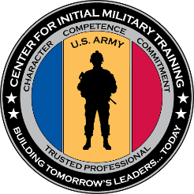









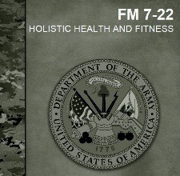



SPIRITUALITY
US Army H2F
https://usacimt.tradoc.army.mil/ACFTGuidance.html
H2F Information Video
https://youtu.be/JC6vrX4jMMU
US Army Chaplain Corps Resources
US Army Chaplain Corps
https://www.army.mil/chaplaincorps
USA-RLA Training
https://usarlatraining.army.mil/
FM 7-22 Holistic Health and Fitness
https://armypubs.army.mil/epubs/DR_pubs/DR_a/ARN30714-FM_7-22-000-WEB-1.pdf
24

Slide 26




Notes
25

Slide 27

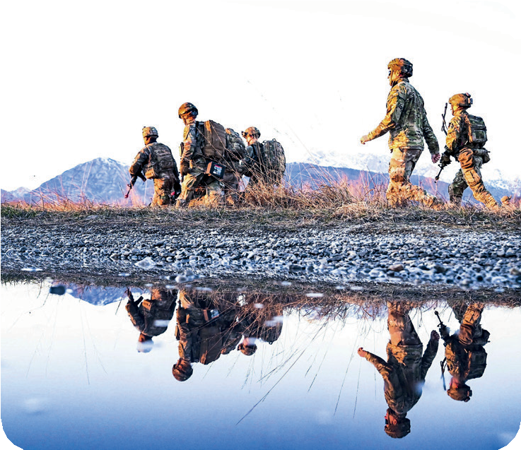
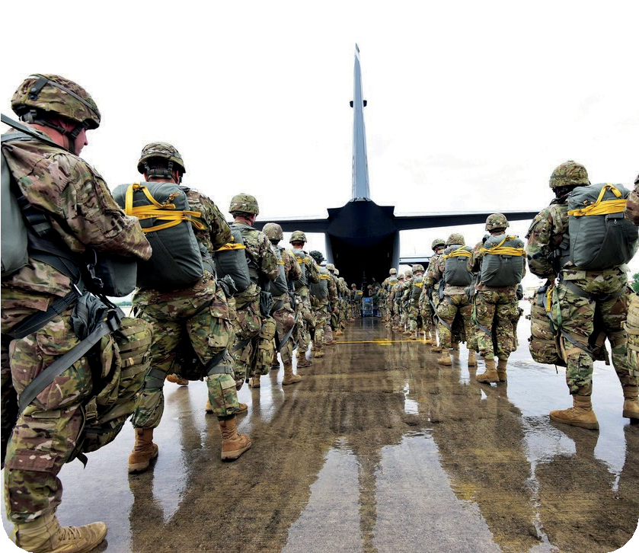
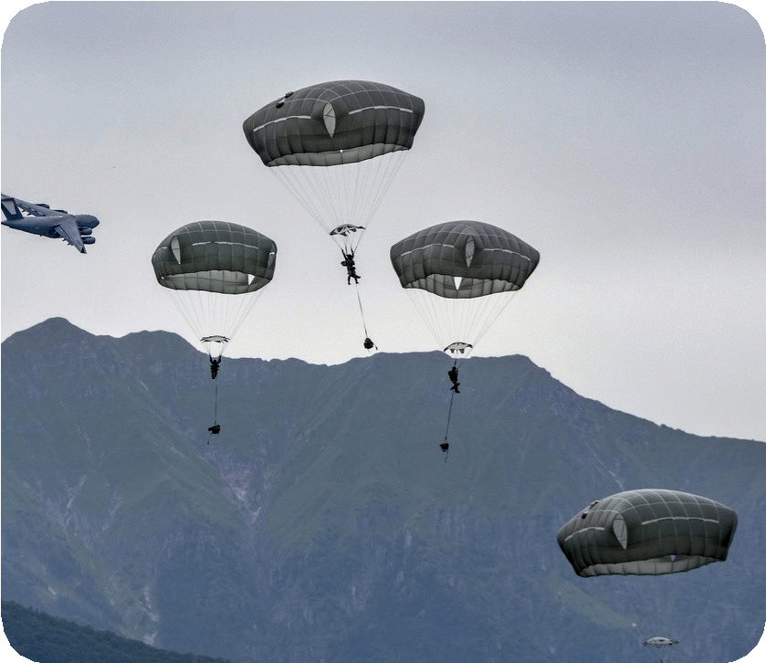
RESOURCES
For help and a personalized plan reach out to your unit chaplain and your local Religious Support Office on you Installation to go deeper.
Counseling is also available from the following sources:
Installation Family Life Chaplains – Available on your post Military One Source 24/7 Support – 800-342-9647 www.militaryonesource.mil/
Veterans Crisis Line
www.veteranscrisisline.net
Text 838255
United States: 800-273-8255, press 1
Europe: 00800-1273-8255 or DSN 118
Korea: 0800-555-118 or DSN 118
Army Suicide Prevention Program
www.armyresilience.army.mil/sucicide-prevention/index.html
26

Slide 28






